Slide 1

STRESS DETECTION USING KEYSTROKES, APPLICATIONS AND MOUSE MOVEMENTS
Name of the Presenter: PRIYANKA TAMANG
Roll No of the Presenter: 22CS8067
Name of the Guide/Supervisor: DR. DEEPANWITA DAS
May, 2026
This image will be replaced with the Graphical Abstract of the work, if any, otherwise skip it.
Department of Computer Science and Engineering
Notes:
NOTE:
To change the image on this slide, select the picture and delete it. Then click the Pictures icon in the placeholder to insert your own image.

Slide 2
Problem Definition/Objective of the work
PROBLEM DEFINITION:
“The problem addressed in this work is the detection of human stress levels using non-intrusive behavioral data such as keystroke dynamics, mouse movements, and application usage patterns.
Traditional stress detection methods rely on physiological sensors like EDA and ECG, which are costly and intrusive.
This project proposes a machine learning-based approach to detect stress using everyday computer interaction data without additional hardware.”
OBJECTIVE:
To develop a machine learning model for stress detection
To analyze behavioral features like keystrokes and mouse movements
To achieve accurate classification using different ML models
To compare performance of models using evaluation metrics
Slide no:

Slide 3
Contribution of your work: Algorithm/Methodology/Flowchart etc.
Dataset Collection
↓
Data Preprocessing (cleaning, handling missing values)
↓
Feature Extraction (typing speed, inactivity, app usage)
↓
Time Series Analysis
↓
Apply ML Models (Random Forest, XGBoost, etc.)
↓
Evaluate using Accuracy, Precision, Recall, F1-score
↓
Identify Important Features
↓
Result Visualization
Slide no:

Slide 4
Outcome of the work: Performance analysis, Comparative discussion, if any.
XGBoost achieved the highest accuracy (~76%)
Random Forest also performed well with high recall
Gradient Boosting and Logistic Regression performed poorly
Tree-based models like Random Forest and XGBoost performed better because they effectively capture non-linear relationships in behavioral data.
MODEL | ACCURACY | PRECISION | RECALL | F1-SCORE
XG BOOST | 76.40% | 0.79 | 0.88 | 0.84
GRADIENT BOOSTING | 32.00% | 0 | 0 | 0
RANDOM FOREST | 74.5% | 0.73 | 0.99 | 0.84
LINEAR REGRESSION | 67.60% | 0.68 | 1 | 0.81
LOGISTIC REGRESSION | 29.41% | 0.2 | 0.01 | 0.03
Table 1: Class-wise Performance (Stressed)
Slide no:

Slide 5
Outcome of the work: Performance analysis, Comparative discussion, if any.
MODEL | ACCURACY | PRECISION | RECALL | F1-SCORE
XG BOOST | 76.40% | 0.68 | 0.52 | 0.59
GRADIENT BOOSTING | 32.00% | 0.32 | 1 | 0.49
RANDOM FOREST | 74.5% | 0.94 | 0.23 | 0.37
LINEAR REGRESSION | 67.60% | 0 | 0 | 0
LOGISTIC REGRESSION | 29.41% | 0.3 | 0.88 | 0.45
This table shows model performance for the non-stressed class
XGBoost shows balanced precision and recall
Random Forest has high precision but lower recall
Logistic Regression shows poor performance due to inability to capture non-linear patterns
Table 2 : Class-wise Performance (Non-Stressed)
Slide no:

Slide 6
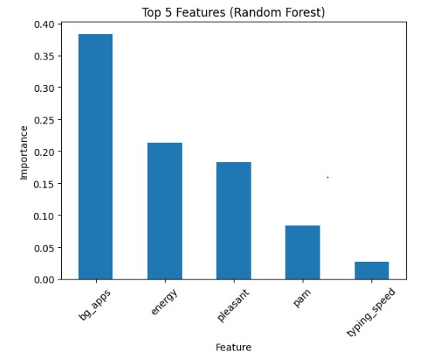
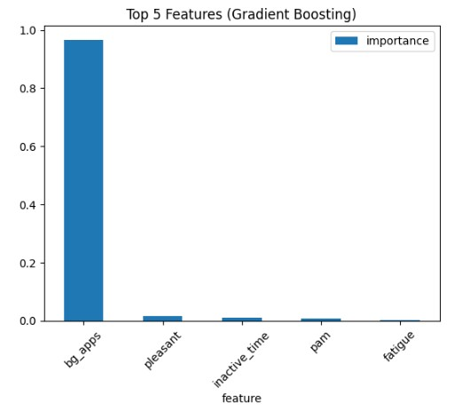
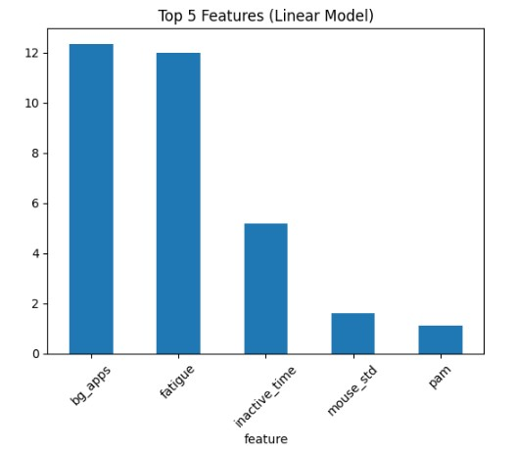
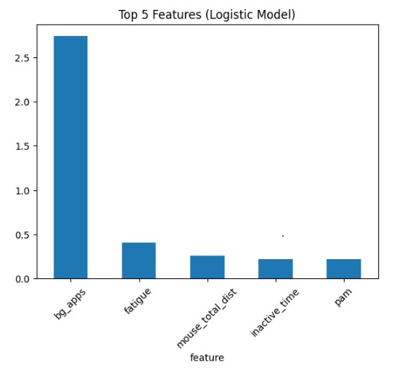
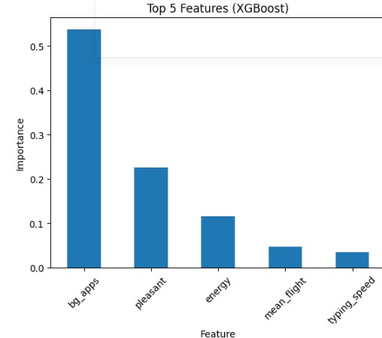
COMMON TOP 5 FEATURES OF EACH MODEL:
Background application count (bg_apps) is the most important feature across all models, indicating multitasking behavior is strongly related to stress.

Slide 7
Conclusion:
This project demonstrates that stress can be effectively detected using behavioral data such as keystrokes, mouse movements, and application usage.
Among all models, XGBoost performed best with balanced accuracy and recall. The study proves that non-intrusive methods can replace traditional sensor-based techniques.
However, performance is limited due to small dataset size, and future work can improve generalization using larger datasets.
This highlights the potential of behavioral analytics for real-world stress monitoring applications.
Slide no:

Slide 8
FUTURE WORK
Use larger and more diverse datasets
Apply deep learning models
Real-time stress detection system
Integration with workplace monitoring systems

Slide 9
References
1. A. Aci´en et al., “Detection of Mental Fatigue in the General Population: Feasibility Study of Keystroke Dynamics as a Real-world Biomarker,” JMIR Biomedical Engineering, 2022.
2. A. Kolakowska, “Towards Detecting Programmers’ Stress on the Basis of Keystroke Dynamics,” Annals of Computer Science and Information Systems, 2016.
3. S. H. Lau, “Stress Detection for Keystroke Dynamics,” Ph.D. dissertation, Carnegie Mellon University, 2018.
4. N. S. D. Chintalapudi et al., “Stress Detection Analysis by Using Keystroke Dynamics,” International Journal of Engineering and Computer Science, 2022.
5. A. Sultanov and K. Kogos, “Insider Threat Detection Based on Stress Recognition Using Keystroke Dynamics,” 2020.
6. D. Naegelin et al., “An Interpretable Machine Learning Approach to Multimodal Stress Detection,” 2023.
7. C. Epp, M. Lippold, and R. Mandryk, “Identifying Emotional States Using Keystroke Dynamics,” in Proceedings of the SIGCHI Conference on Human Factors in Computing Systems (CHI), pp. 715–724, 2011.
8. L. Vizer, L. Zhou, and A. Sears, “Automated Stress Detection Using Keystroke and Linguistic Features,” International Journal of Human–Computer Studies, vol. 67, no. 10, pp. 870–886, 2009.
9. L. Giancardo et al., “Computer Keyboard Interaction as an Indicator of Micro-Motor Impairments,” Scientific Reports, vol. 5, Article 16416, 2015.Stress Detection Using ML.
10. J. Hernandez, D. McDuff, and R. Picard, “Multimodal Behavioral Biometrics for Stress Detection,” IEEE Transactions on Affective Computing, 2021.
11. Chamindu Weerasinghe, “Stress Detection by Keystroke, App and Mouse Changes,” dataset 2021, available on Kaggle
Slide no:

